Slide 1
OVERVIEW of YouTube Data Analytics
Presented By:
Gayatri Korde
Shradha Kakade
N.Mounika
Balwander Singh
Rohit Tambwekar

Slide 2
Why did we choose this topic?
Relevance and Popularity.
Growing Influence of Video Content.
Content Optimization.
Feedback and Improvement.
Educational Value.
Importance:
1. Audience Understanding.
2. Monetization.
3. Goal Tracking.
4. Business Purpose.
5. Growth and Success of both creators and businesses.

Slide 3
Overview of YouTube Data Analysis:
YouTube is launched in 2005, YouTube is the biggest video-sharing platform and the second-biggest social media in the world, with over 2.70 billion users.
It is estimated that the number of YouTube’s global user count will reach 2.85 billion by 2025.

Slide 4
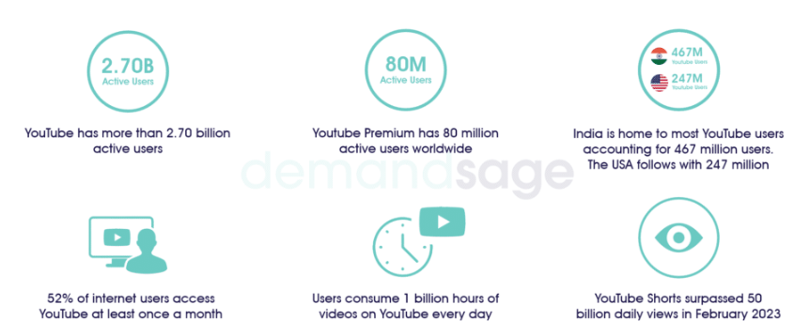
YouTube Data Analysis

Slide 5
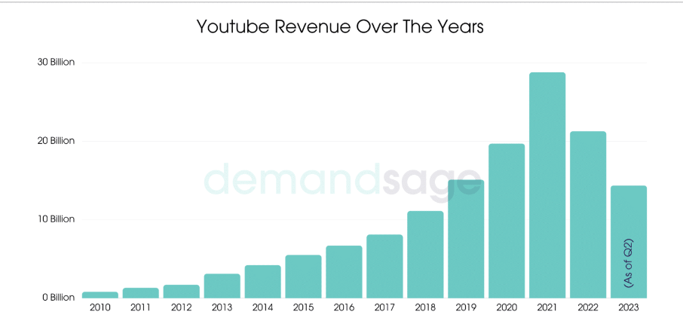
YouTube Revenue

Slide 6
YouTube Active Users
As of 2023, YouTube has over 2.70 billion monthly active users.
It is estimated that over 122 million people visit YouTube every day via its Website and Apps.
62% of YouTube users in the U.S.A. access the platform daily. That is equivalent to 153.14 million people.
Users consume 1 billion hours of videos on YouTube every day.
Content worth 500 hours is uploaded on YouTube every day.

Slide 7
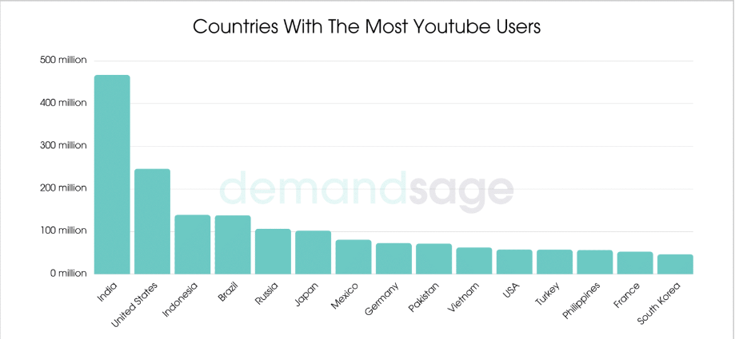
YouTube Users

Slide 8
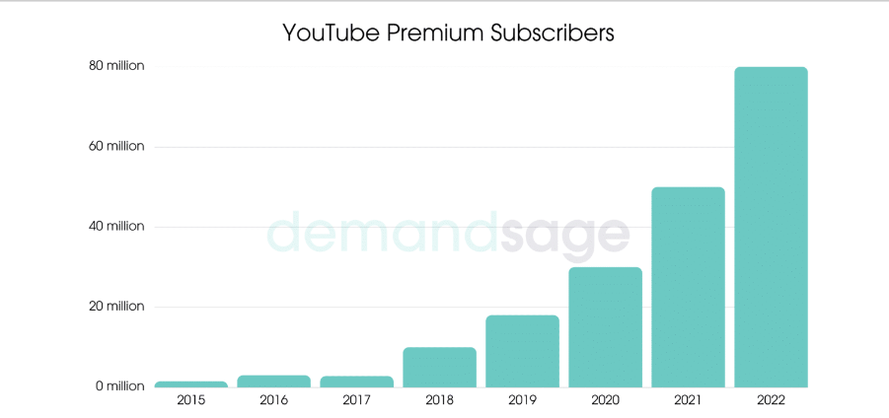
YouTube Premium Subscribers

Slide 9
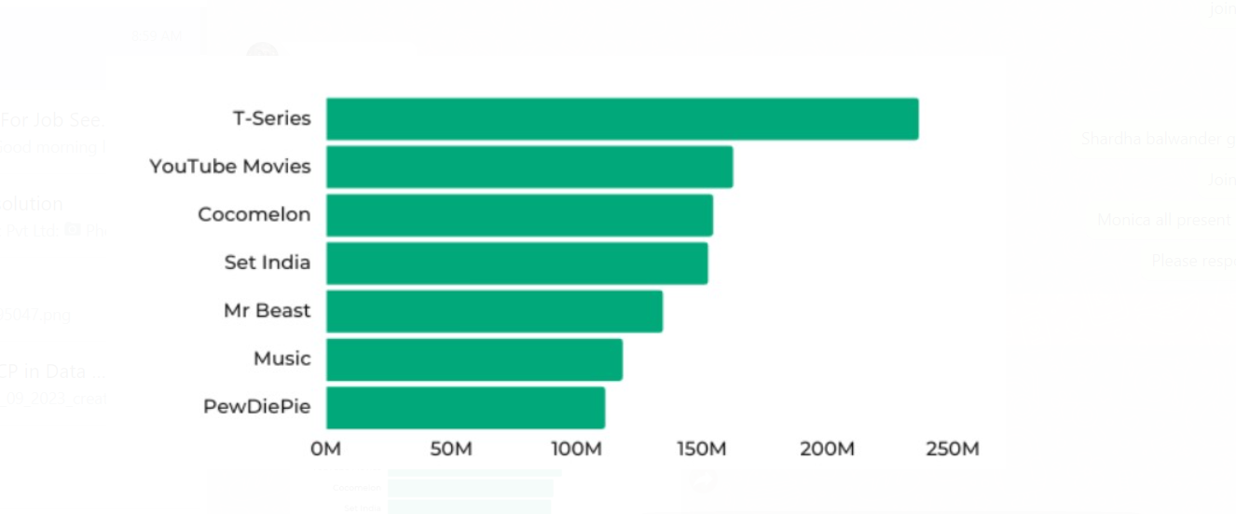
YouTube Channel Statistics

Slide 10
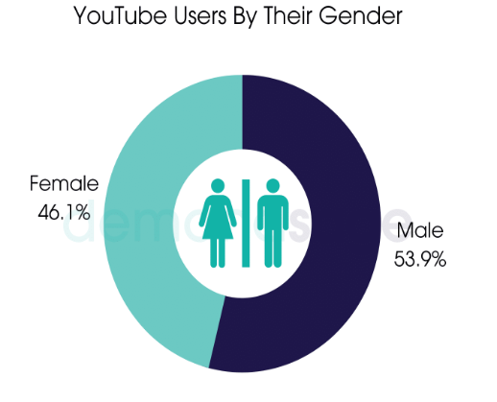
YouTube user by their Gender

Slide 11
Applying EDA to YouTube Data
Definition of EDA
Purpose
Benefits
Data Sources (APIs, CSV exports, etc.)
Types of Data (Views, Likes, Comments, etc.)

Slide 12
Conclusion
I hope we were able to give you an in-depth view of YouTube to plan out your next YouTube growth strategy.
All the figures point towards one thing: you tube's popularity has been soaring through the years, and its usage is increasing. Creators are earning millions, and businesses are spending more on advertising on the platform.

